Slide 1


Yousef Abdelsalam
AI
ETHICIST
My ePortfolio!
4 April 2025
01

Slide 2
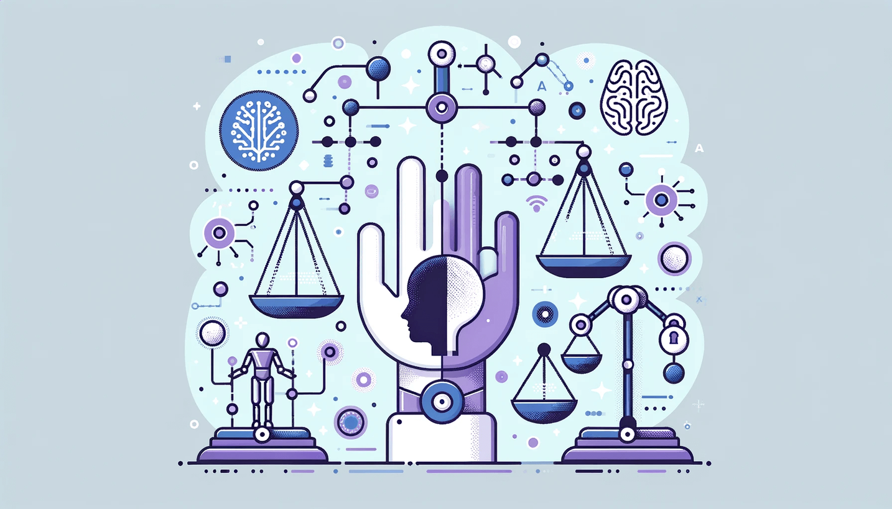
Yousef
THE RESPONSIBILITIES
Developing​
AI Ethicists craft comprehensive guidelines and policies that direct responsible AI development. [1]​​
Establishing​
They set forth standards to ensure AI development adheres to ethical principles and societal norms. [1]​
Conducting​
Before an AI project goes live, AI ethicists conduct a review to identify potential ethical issues and suggest remedies. [1]​
Assessing​
They actively evaluate potential risks associated with AI projects and ensure these projects comply with existing ethical guidelines and regulations. [1]
Collaborating​
AI ethicists work closely with developers, product managers, legal experts and other team members to integrate ethical considerations into every stage of AI development.[1]​​
Educating and raising​
They educate team members about ethical AI practices, fostering a culture of responsibility and ethical consciousness within the organization. [1]​
02

Slide 3
Yousef
REQUIRED SKILS
Undergraduate Degrees in Related Fields: Begin with an undergraduate degree in computer science, philosophy or social sciences. These areas provide a foundational understanding necessary for AI ethics.[1]​
Master’s Programs in AI with an Ethics Focus: Pursuing a Master’s degree in AI that emphasizes ethics can equip you with the specialized knowledge required in this field.[1]​
Specialized Programs that Combine AI and Ethical Studies: Certain programs offer a combination of AI and ethical studies, offering a comprehensive understanding of how these areas intersect.[1]​
03

Slide 4
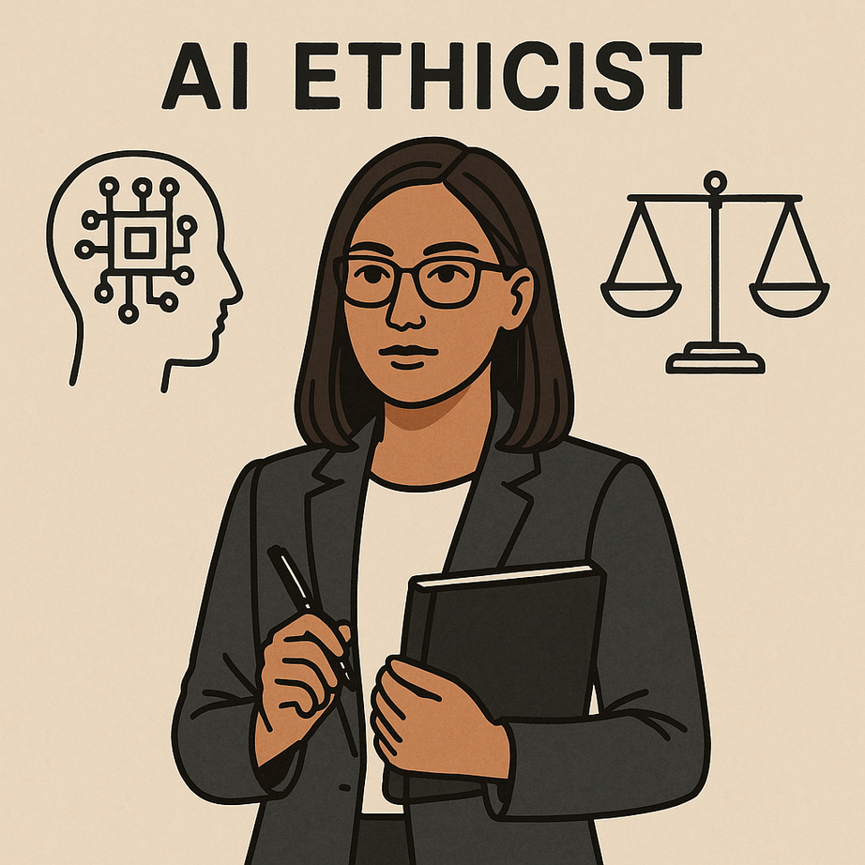
Yousef
WHAT IS THE AVERAGE SALARY AS AN​
AI ETHICIST​
The average salary for AI ethicists is projected to be anywhere from $120,000 to $150,000 per year but it is one of the newer positions, hence not a common position.[2]​
04

Slide 5
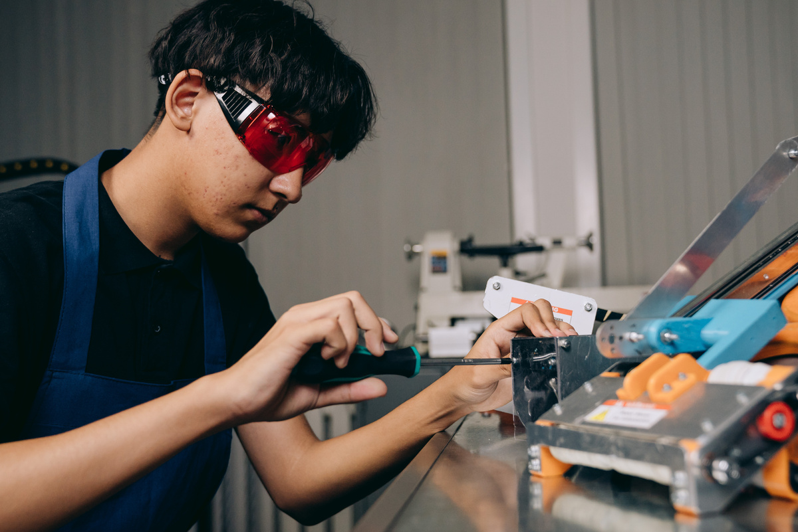
Yousef
IMPACT OF AI​
AI ethicists are important in AI ethics because they understand biased algorithms, privacy concerns, responsible AI development, and AI applications.
Privacy Concerns​
They address privacy issues by ensuring that AI systems, such as those used in surveillance and data analytics, respect user privacy and comply with data protection laws. Their efforts are vital in maintaining trust and ensuring that the deployment of AI technologies does not infringe on individual rights or freedoms.[3]​
05

Slide 6
Yousef
QUESTIONS
Is this a job you’d actually want?​
•So far, From all of the research, I can see that this is a kind of job I kind of want, I can see that it can help the AI, lead it to the right direction
What are the pros & cons?​
In the next slide
Could AI replace this job?​
Ai can’t replace this job, this job is rooted with human ethics, and moral judgement that AI can’t do. [4]​
Some key points:​
Human Judgment and Moral Reasoning: AI lacks the capacity for moral judgment and ethical decision-making, which are central to the role of an AI Ethicist.​
Ethical Implications of AI in the Workplace: While AI can enhance efficiency in various tasks, it should not replace human roles that necessitate creativity, empathy, and complex problem-solving. ​
06

Slide 7
Yousef
PROS AND CONS
PRO
Important Role: AI ethicists play a crucial part in ensuring AI systems operate fairly and responsibly, preventing harm and promoting ethical standards. [5]​
Easy to Find a Job[5]​
Attractive Salary: The specialized nature of the role often comes with competitive compensation packages.[5]​
Intellectually Stimulating Work[5]​
CON
High Responsibility: AI ethicists bear significant responsibility in guiding AI development, which can be stressful.[5]​
Interdisciplinary Challenges: The role requires knowledge across multiple fields, including technology, law, and philosophy, which can be demanding.[5]​
Evolving Field: The rapid advancement of AI technologies means that ethical guidelines are continually changing, requiring constant adaptation.[5]​
07

Slide 8
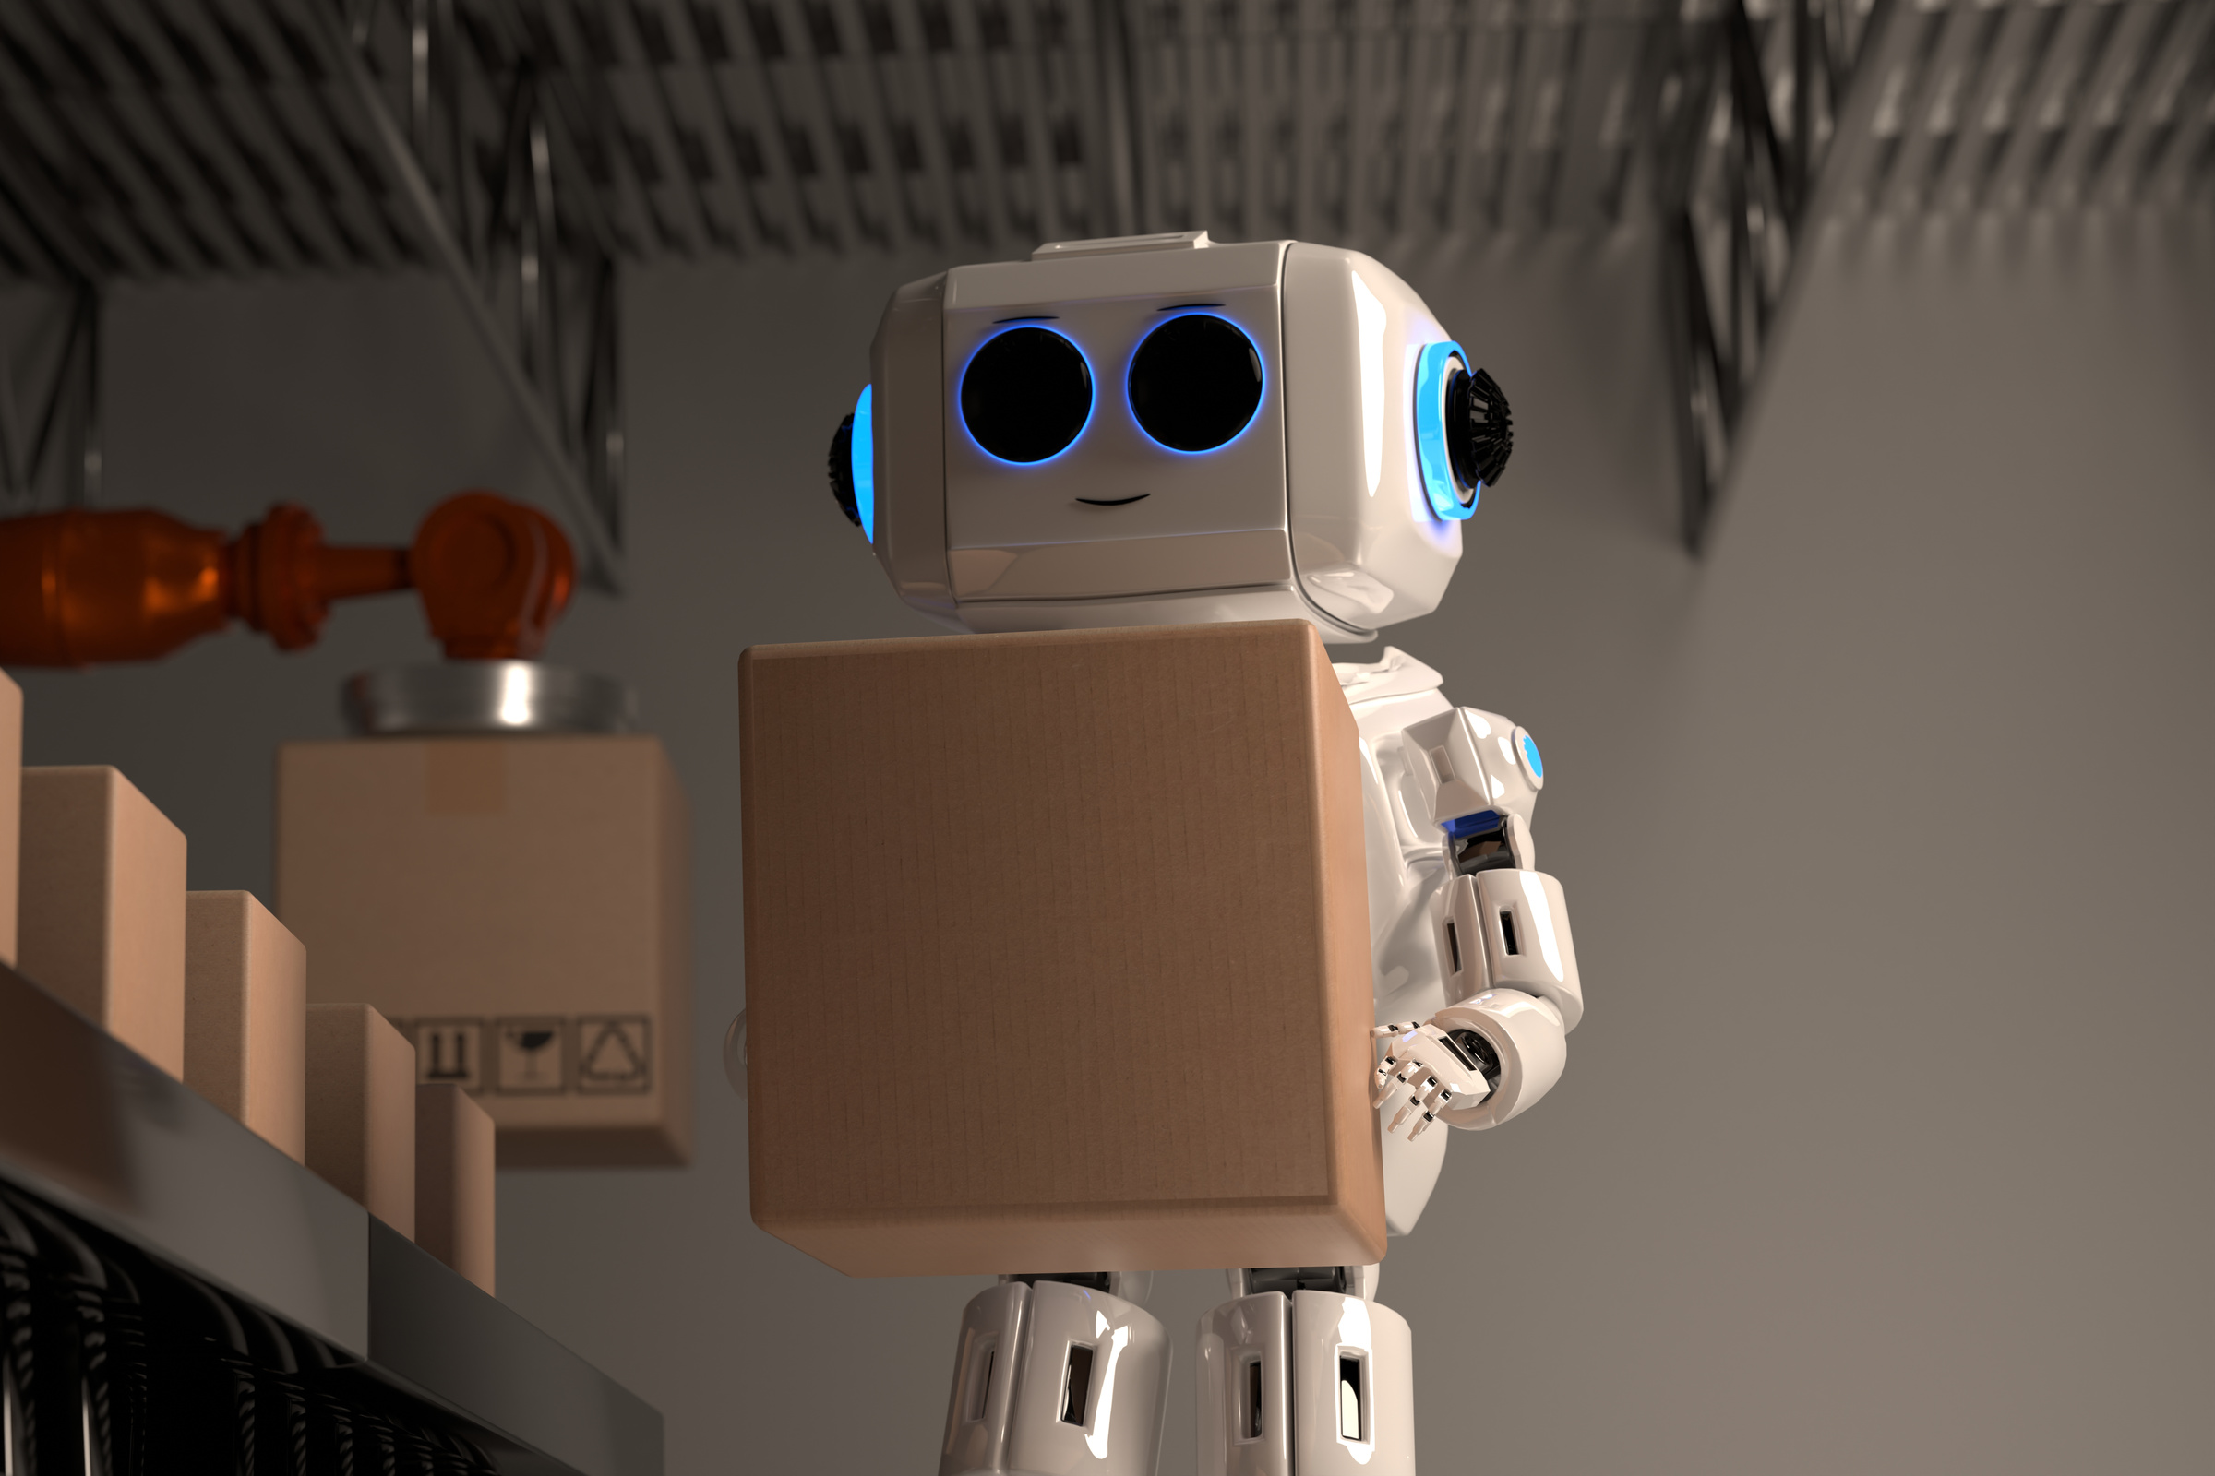
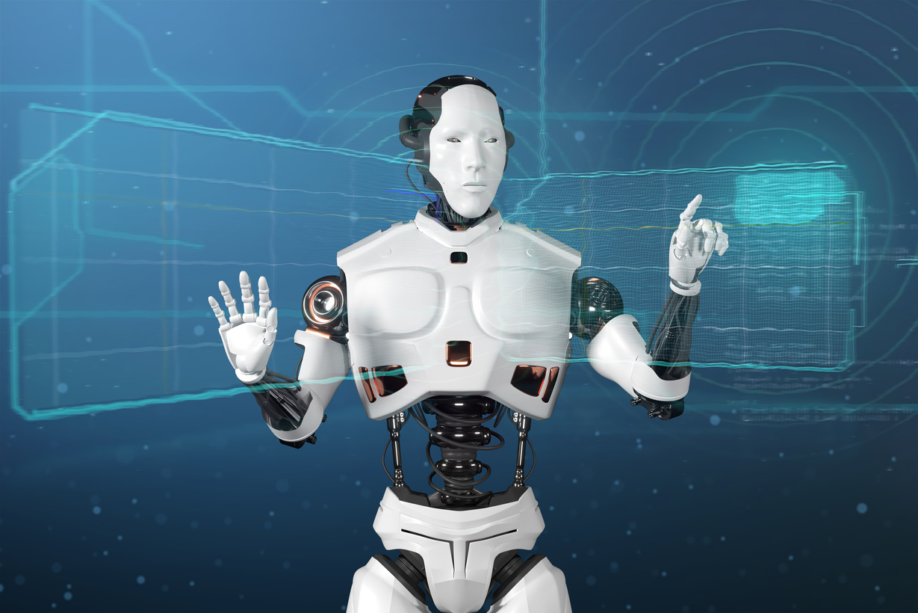
Yousef
Here are some links that talk about this topic a bit more:
https://news.harvard.edu/gazette/story/2020/10/ethical-concerns-mount-as-ai-takes-bigger-decision-making-role/
https://apnews.com/article/vatican-artificial-intelligence-ethics-pope-risks-warnings-231b4b7b8ed6a195ec920f1f362c15e2
https://time.com/6338489/ai-work-jobs/
LINKS (NOT CITATIONS)
08

Slide 9

Yousef
CITATIONS
[1]= (2025, March 27). Ai ethicists: Who are they? and how to become one. University of San Diego Online Degrees. https://onlinedegrees.sandiego.edu/ai-ethicist-career/
[2]= https://northwest.education/insights/technology/top-10-highest-paying-ai-jobs/
[3]=https://mondo.com/insights/emerging-roles-in-tech-need-for-ai-ethics-and-impact/
[4]=https://www.brillicaservices.com/blogs/will-artificial-intelligence-replace-humans
[5]=https://outstandingstar.com/pros-and-cons-of-being-an-ai-ethicist/
[6]=https://medium.com/%40ZaradarTR/the-ethical-quandary-of-ai-replacing-human-roles-a-veteran-developers-perspective-750807564549
09

Slide 10
Yousef
THANK YOU
10

